Slide 1
HASO: A Hot-page Aware Scheduling Optimization Method in Virtualized NUMA Systems Butian Huang
butine@zju.edu.cn

Slide 2
Outline
Introduction
Background And Motivation
Design And Implementation
Performance Evaluation
Conclusion And Future Work

Slide 3
Introduction
The competition for resources sharing between VMs
CPU overcommit
Memory overcommit
Cache contention
Virtualization poses additional challenges
The VM scheduler is unaware of the underlying NUMA architecture
NUMA scheduling
Memory migration
Notes:
We have seen the complexity of scheduling VMs on NUMA architectures. Typically, one NUMA server holds tens or hundreds of VMs, if the VM scheduler is unaware of the underlying NUMA architecture, the virtualized system performance will suffer a lot, And also lead to unpredictable VM performance behavior, this will harm the use experience of cloud users.

Slide 4
Key contributions
Propose the HASO method
Solve the elimination hot NUMA node problem in vNUMA syatems
Provide a HASO scheduling system
Perceive the hot NUMA nodes and VM hot pages using a 5-bitmap method
Predict the future hot pages of hot VMs and eliminating hot node scheduling with minimized VM migration cost
Present overall performance evaluation experiments
Notes:
The key contributions of this paper can be summarized as follows. (1) We have proposed the HASO method to solve the elimination hot NUMA node problem in vNUMA systems. (2) We have provided a HASO scheduling system to perceive the hot NUMA nodes and VM hot pages identified with a state weight using a 5-bitmap method. (3) We designed some novel algorithms for predicting the future hot pages of hot VMs and eliminating hot node scheduling with minimized VM migration cost. (4) We have presented overall performance evaluation experiments to demonstrate the effectiveness of the HASO method.

Slide 5
Outline
Introduction
Background And Motivation
Design And Implementation
Performance Evaluation
Conclusion And Future Work

Slide 6
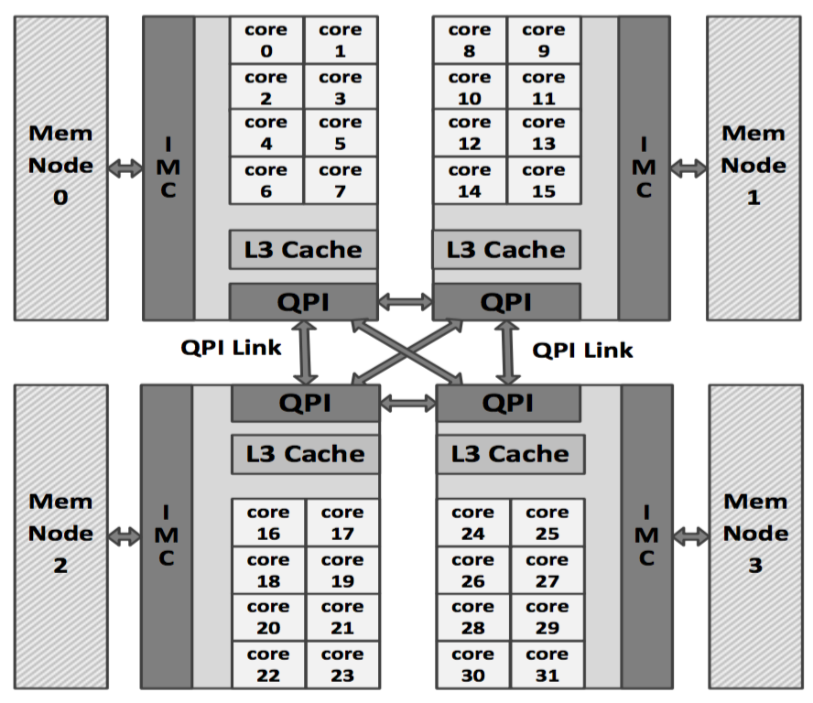
NUMA architecture
Commercial servers are NUMA now!
NUMA (Non-Uniform Memory Access) architecture
Notes:
we present a NUMA multicore machine with four NUMA nodes (CPU sockets) in Fig.1. Each CPU socket has eight cores, which share a last-level cache (L3 cache), an inte- grated memory controller (IMC), and an Intel QuickPath Interconnect (QPI). The cores together with their private L1 and L2 caches are called the ”core” memory subsystem. The shared L3 cache, the IMC, and the QPI together form the ”uncore” memory subsystem. The cache line requests from the cores are queued in the Global Queue (GQ) and serviced by the uncore. The physical memory is divided into four memory nodes. Each node is directly connected to a processor.

Slide 7
NUMA performance
NUMA performance overhead factors
Remote memory

Slide 8
VM Scheduling on NUMA
NUMA performance overhead factors
Remote memory
Cache contention

Slide 9
VM Scheduling on NUMA
NUMA performance overhead factors
Remote memory
Cache contention
Memory controller contention

Slide 10
VM Scheduling on NUMA
NUMA performance overhead factors
Remote memory
Cache contention
Memory controller contention
Interconnect contention

Slide 11
Motivation
VMs running memory-intensive application
Memory overcommit
Some NUMA nodes overloaded or in a hot state
Hotspot elimination problem
Find the VMs with a large number of hot pages
Predict the future hot pages used in VM memory migration
Notes:
The node being overloaded or hot will provide a serious impact on application performance in vNUMA system. This motivates us to solve the problem. We call it as a hotspot elimination problem. The core task of our work is to optimize the migration of VM or hot pages between nodes. But whole VM migration with a large amount of memory will be very unrealistic. We attempt to find the VMs with a large number of hot pages and migrate the hot pages to other node with low load so as to eliminate the hot node. According to the time or space locality principle, we can predict the future hot pages used in VM memory migration.

Slide 12
Outline
Introduction
Background And Motivation
Design And Implementation
Performance Evaluation
Conclusion And Future Work

Slide 13
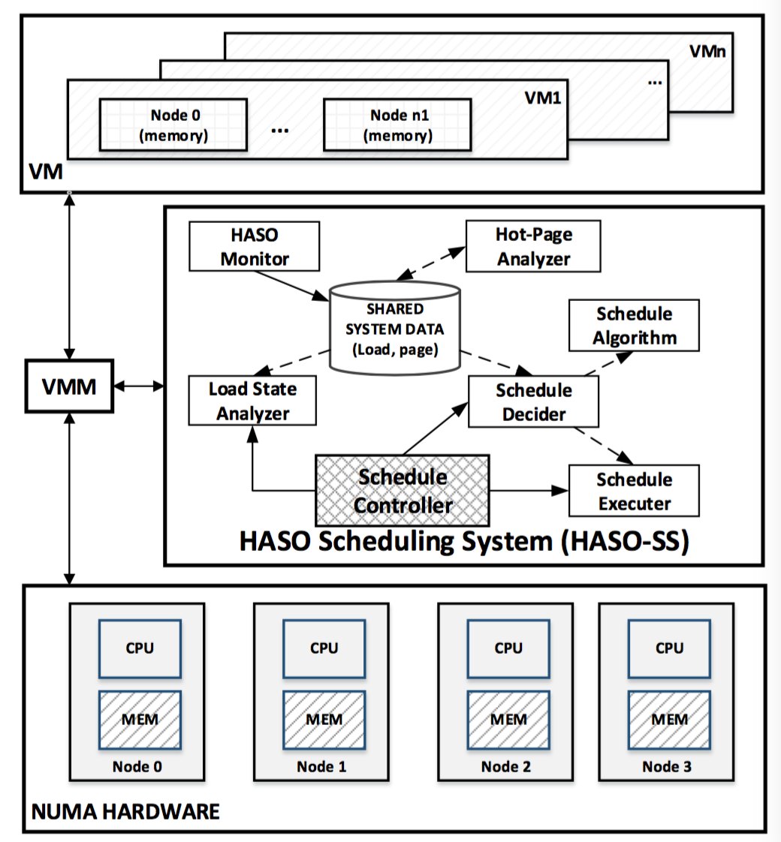
HASO Scheduling System
Notes:
The HASO monitor is responsible for monitoring the load and memory page access information. The load information includes the CPU usage, memory usage of NUMA nodes and VMs. It periodically captures the load and memory page access information and stores into a shared system data base or storage. The load state analyzer can read the load data and check the load status including the nodes and VMs, for example, the node load is in overloaded or a hot state and unbalance, or VM is overloaded. The hot-page analyzer (HPA) is responsible for the analysis of memory page access state information and recording the state into a dynamically built memory page bitmap storage. The scheduler controller module is the core of HASO-SS in charge of controlling and managing the system schedule operations. It regularly invokes the LSA module to check the NUMA node system states. If a node is in hot status, it immediately triggers a hot node elimination scheduling decision request and sends the request to the SD module. The SD module calls a special schedule algorithm to make decision to schedule and gives an optimal schedule scheme result. The SD module returns the specific schedule scheme back to the SC module. In the end, the SC module calls the schedule executer to execute the specific scheduling operations.

Slide 14
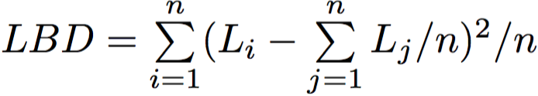
Discover hot node and select hot VMs for migration
Hot node and hot VM
Hot node discovery
Select hot VMs for memory migration
Notes:
Definition 1: Hot node or VM. Let HOT be a threshold. A hot node is defined as a NUMA node with a load usage higher than HOT, such as 80%. A hot VM is also defined as a VM with a load usage higher than the given HOT.
in situation of CPU and memory overcommit, we think that if a vNUMA system are load unbalanced between all nodes, then there must be some hot nodes. We introduce a load balancing degree (LBD) to denote a system overall load balance state and think that if the LBD is too large or larger than a given threshold, then some node load must be overloaded or hot.

Slide 15
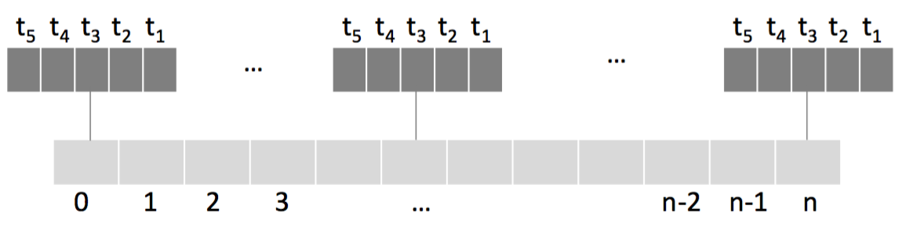
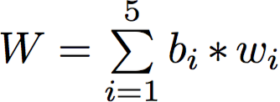
Select hot memory blocks
Record the access state of memory pages
Precise Event-Based Sampling (PEBS)
Store the access state of hot pages
Five-bitmap
The weight of the page
Notes:
if the memory access state of a page is being used, then we set a state value as 1 for this page, otherwise 0. For the memory page, we check and get one state value per time interval. At each time interval, we can have a set of hot memory pages identified with a state value. We define a hot page candidate set P to record the obtained pages and set it as Ø initially. Let i be an integer, Pi be a set of hot memory pages we check and get at the ith time interval. Then, we union Pi to P and get a new P, namely, P = P ∪ Pi. Obviously, with the past of several time intervals, the P will become increasingly bigger.
For example, if a page has a five state bits string ”01110”, then the weight of the page is 9, which is computed by the expression, 0∗5+1∗4+1∗3+1∗2+0∗1.

Slide 16

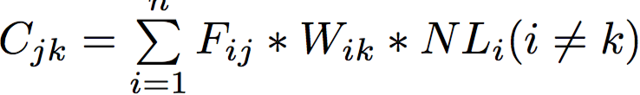
Select hot memory blocks
Building future hot memory blocks as migration candidates
K-means clustering techniques
Hot node elimination scheduling algorithm
Notes:
Each page x has two attributes, namely the page index ex and the five bits state weight wx. Let X be a hot page set,∀x∈X,x has the form<ex,wx>.WeperformK- means clustering techniques [11] on X to divide the page set into K clusters, where K is an integer parameter.
Let Fij be the memory pages of VMj on the nodei, k be the migration destination node of the VM j, and Wik be
the weight of the node k, then the migration cost of the VM n j can be calculated as Cjk = Fij ∗ Wik ∗ NLi(i ̸= k).

Slide 17
Outline
Introduction
Background And Motivation
Design And Implementation
Performance Evaluation
Conclusion And Future Work

Slide 18
Experimental environment
Experiment Platform
Dell R910：Processor type(Intel Xeon E7520); Number of cores(4 sockets);
Clock frequency(1.87 GHz);L3 cache(18MB shared);
Memory(4 memory nodes, each with 16GB)
Virtualization Environment
QEMU-KVM 1.2.2, host/guest OS Ubuntu 12.04 with Linux kernel 3.10.7
Benchmarks
NAS Parallel Benchmark (NPB)
HPC Challenge benchmark(HPCC)

Slide 19
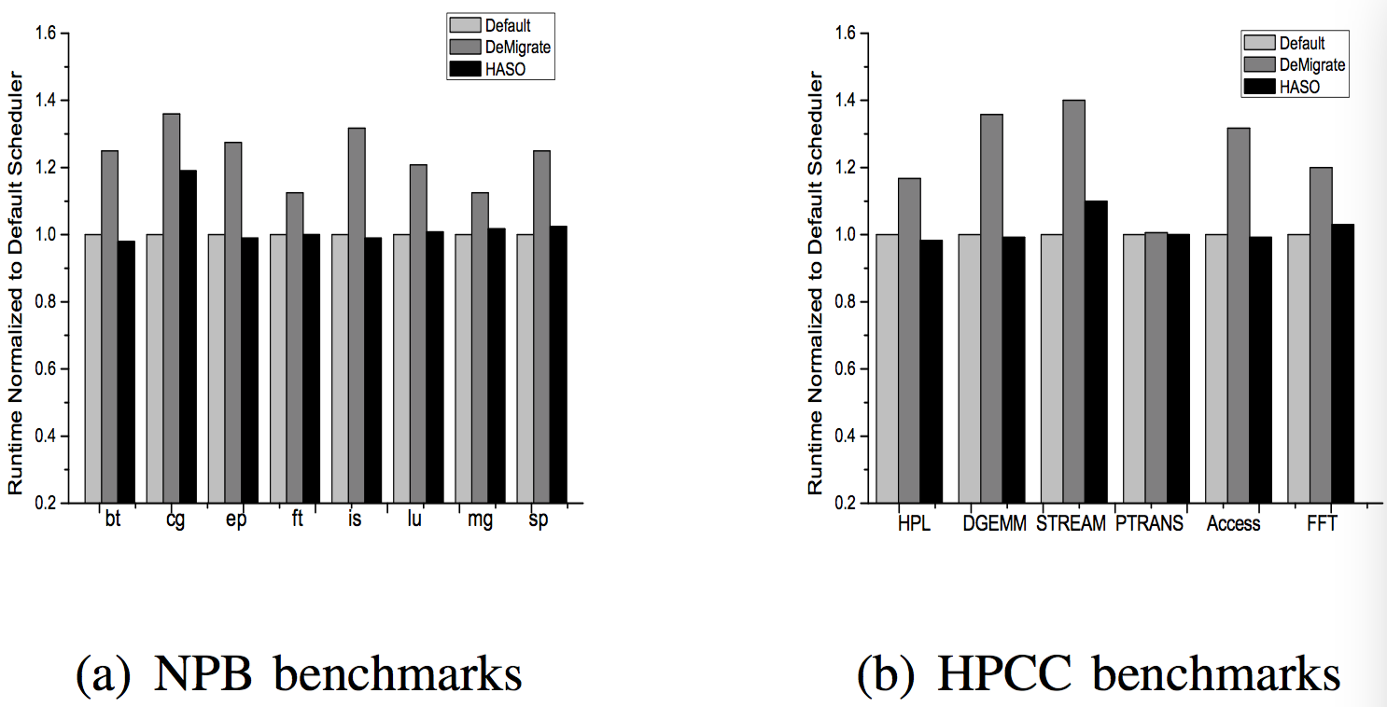
VM migration performance
Notes:
We evaluate the performance of VM migration between NUMA nodes. We place a VM in the NUMA node 0, which is configured with 8 vCPUs and 16 GB memory and run the NPB benchmark in this VM. In the process of running the benchmark in VM, at first, we use the default VM migrate strategy, which migrates VM as a whole. And then, we use the HASO method strategy which migrates the VM hot pages to other NUMA nodes. Our experimental results show that the sample interval cannot be too small and the suitable value is set to 30s.
Figure (a) shows the runtime of NPB benchmarks under three different strategies: the default CFS scheduler (Default), the default VM migrate strategy (DeMigrate), and the HASO strategy. Figure (b) shows the runtime of HPCC benchmarks under three different strategies: the default CFS scheduler (Default), the default VM migrate strategy (DeMigrate), and the HASO strategy. We found that the HASO strategy cannot affect the migrated VM’s performance, and can improve the overall performance of NUMA machine.

Slide 20
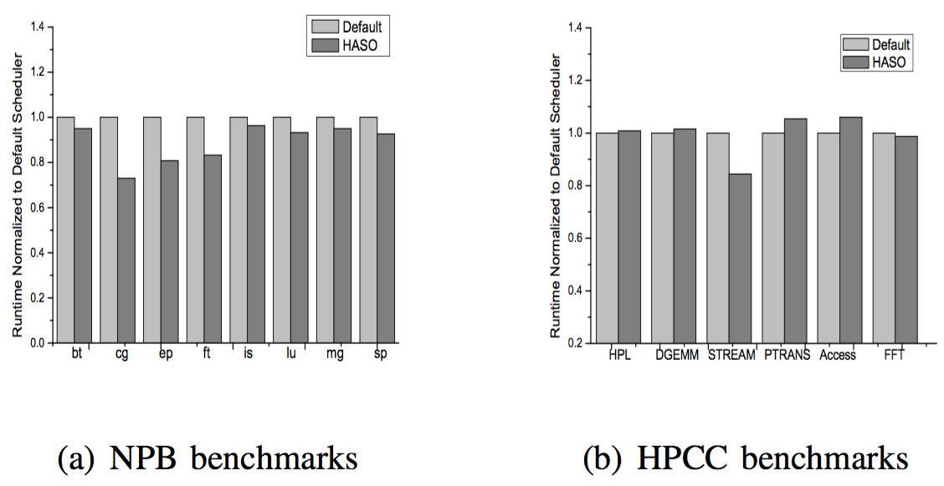
VM application performance
Notes:
We create 8 VMs on R910 server, every VM is configured with 4 vCPUs and 4GB memory and bound to a single NUMA node, as shown in Table 2. Inside each VM, we run one 8-threaded NPB-OMP benchmark.
Figure (a) shows the runtime of NPB benchmarks under the default CFS scheduler (Default) and the HASO scheduler (HASO). We can see that HASO strategy is more effective for memory-intensive benchmarks. The VM hot pages is the main reason of cg benchmark’s performance degradation. HASO strategy improves the performance of cg significantly by 27.06%, ep by 19.2%, ft by 16.8%, while performance improvement of other benchmarks is not obvious.
Figure (b) shows the runtime of HPCC benchmarks under the default CFS scheduler (Default) and the HASO scheduler (HASO). We can also see that HASO strategy is more effective for memory-intensive benchmarks. Stream benchmark is memory-intensive. HASO strategy improves the performance of stream by 15.63%, and cannot improve the performance of other benchmarks.

Slide 21
Outline
Introduction
Background And Motivation
Design And Implementation
Performance Evaluation
Conclusion And Future Work

Slide 22
Conclusion And Future work
Conclusion
Propose the HASO method to eliminate the hot node.
Provide 5-bitmap method to record the VM memory access states.
Provide K-means technique to cluster hot pages and predict future hot page blocks used to migrate.
Future work
Our HASO method can be continued to be optimized by tuning some parameters.
Improve performance of CPU-intensive applications based on hot pages in virtualization.

Slide 23
Thanks !
Butian Huang
butine@zju.edu.cn

